Slide 1
Greg’s Python Course TA recitation
Younsoo Kim

Slide 2
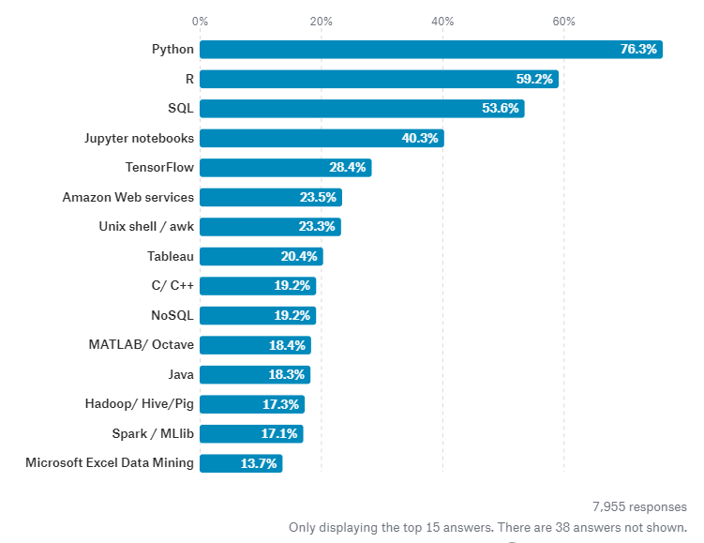
1. Why Python?
The most popular language!
Easy to learn front-end language

Slide 3

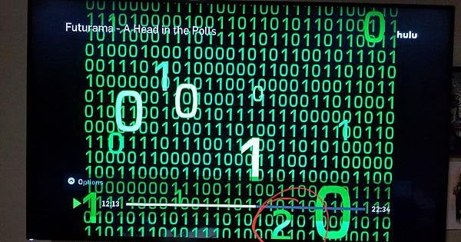
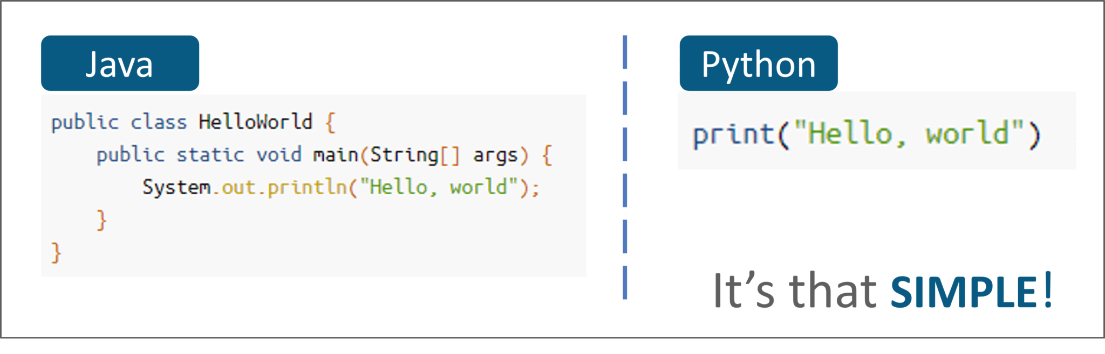
1. Why Python?

Slide 4
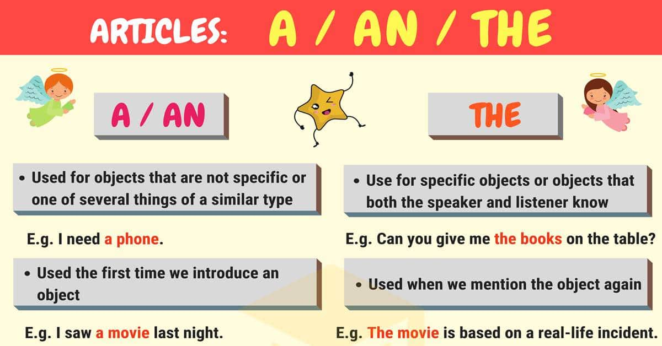
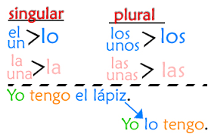
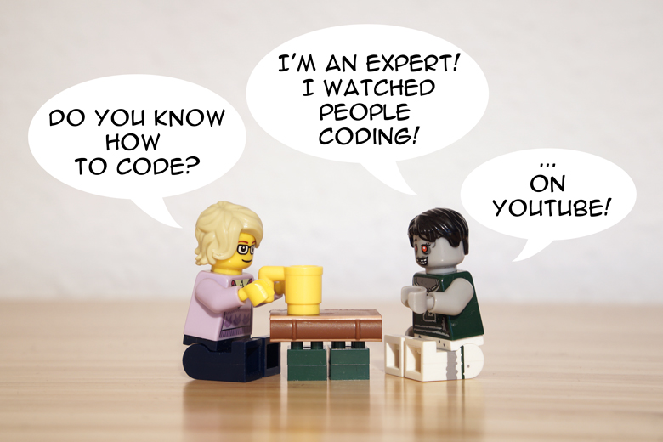
1. Why Python?
https://thevaluable.dev/how-to-learn-programming-language/
https://www.senorjordan.com/01-direct-objects/
https://7esl.com/english-articles/

Slide 5
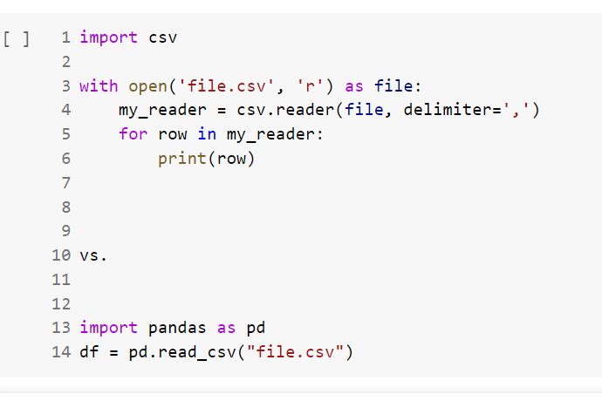
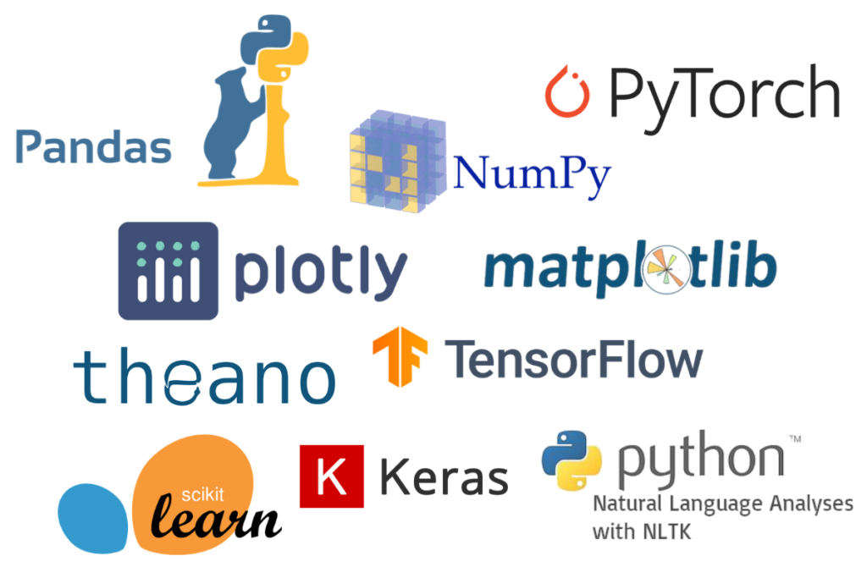
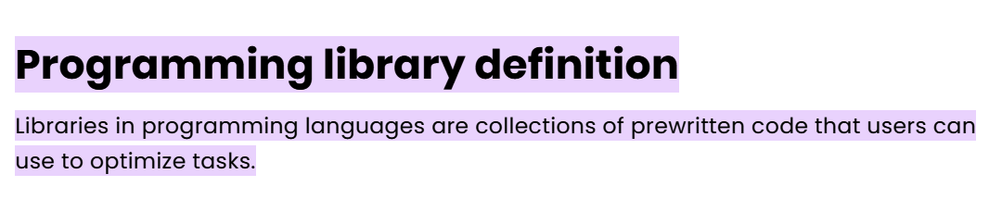
2. What and why library?
https://www.idtech.com/blog/what-are-libraries-in-coding#:~:text=Programming%20library%20definition,can%20use%20to%20optimize%20tasks.
https://www.fireblazeaischool.in/blogs/python-libraries-for-machine-learning/

Slide 6
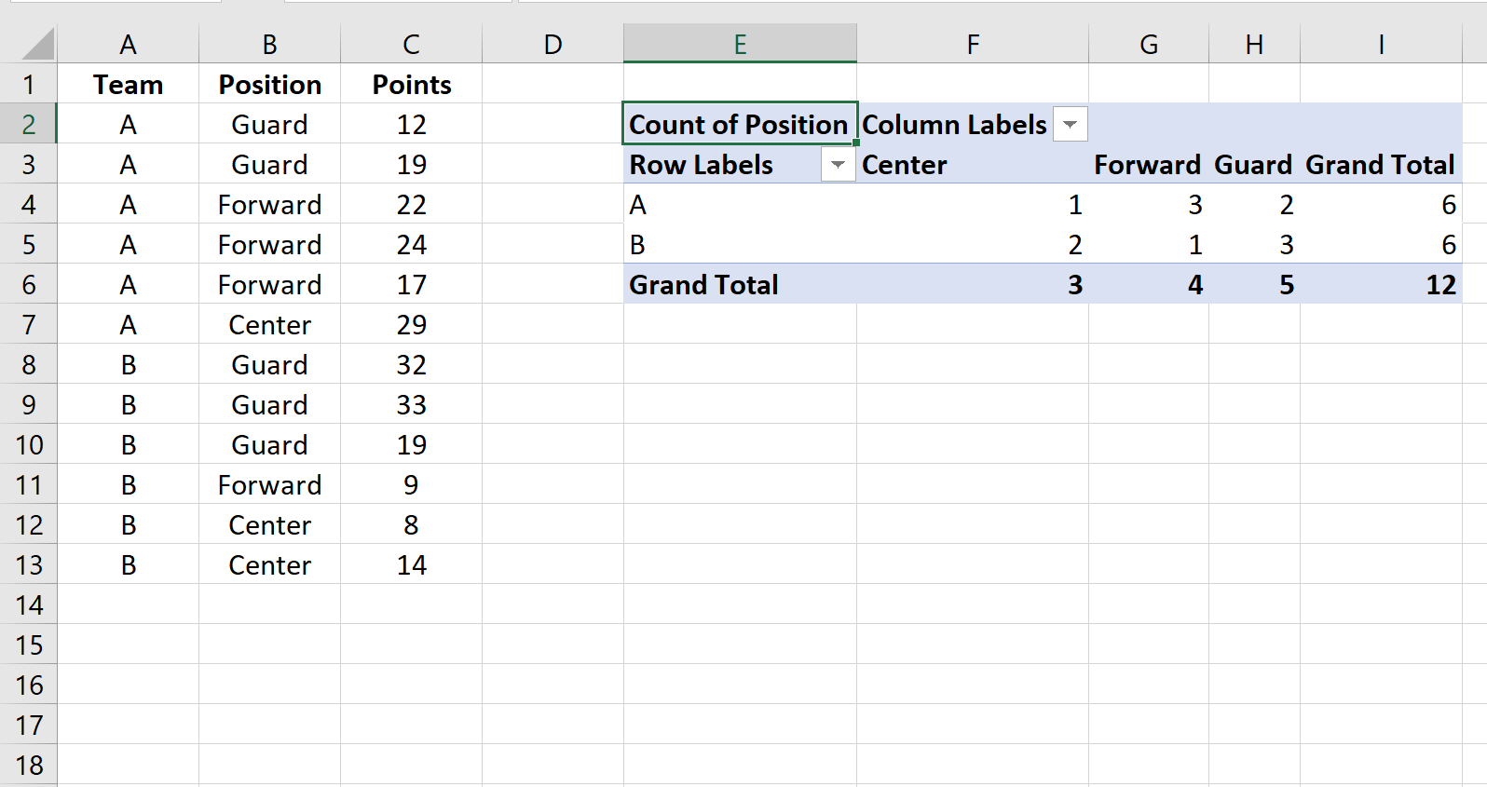
3. What is crosstab?
A crosstab is a table that summarizes the relationship between two categorical variables. (Excel: Pivot Table)
Contingency table
https://www.statology.org/crosstab-excel/

Slide 7
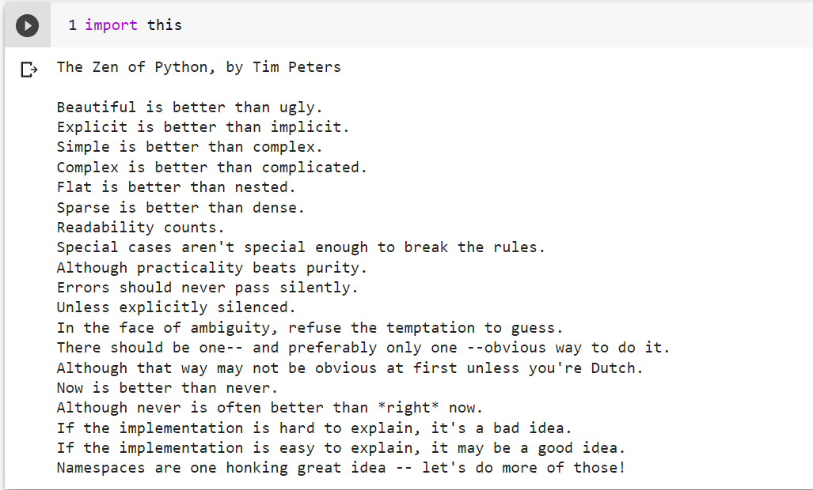
Short, but contains all the necessary information
For readability, snake or capitalized

Slide 8
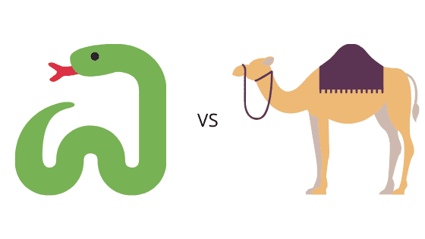
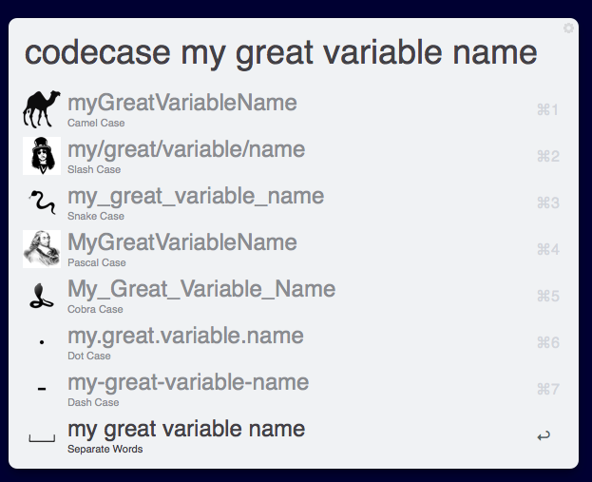
4. Variable naming conventions
Snake: youn_soo_kim
Camel: YounSooKim
Cobra: Youn_Soo_Kim
https://www.alfredforum.com/topic/4818-code-case/
https://codebrahma.com/intercepting-the-case-battle-between-snakes-and-camels-in-front-end-javascript/

Slide 9

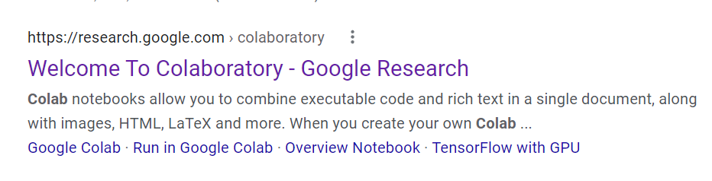
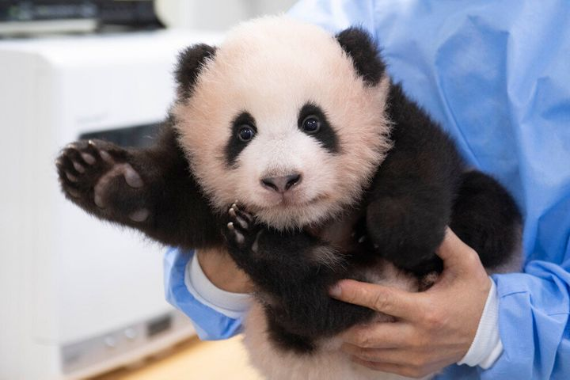
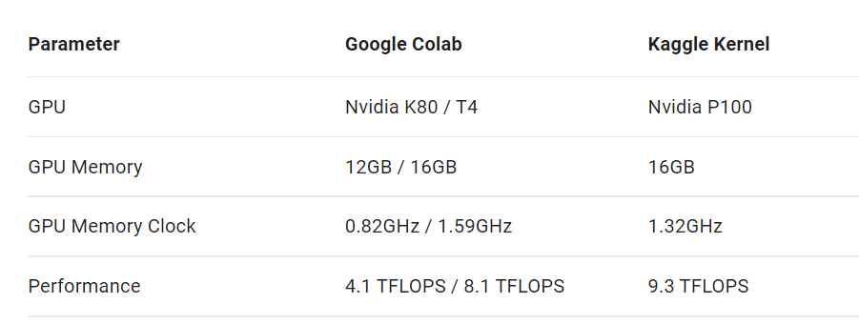
5. Practice for Pandas with Colab

